Slide 1
Digital Fundamentals
CHAPTER 2 Number Systems, Operations, and Codes
1
Notes:
1
1
1

Slide 2
Chapter Outline
2–1 Decimal Numbers
2–2 Binary Numbers
2–3 Decimal-to-Binary Conversion
2–4 Binary Arithmetic
2–5 Complements of Binary Numbers
2–6 Signed Numbers
2–7 Arithmetic Operations with Signed Numbers
2–8 Hexadecimal Numbers
2–9 Octal Numbers
2–10 Binary Coded Decimal (BCD)
2–11 Digital Codes
2–12 Error Codes
Notes:
2
2
2

Slide 3
Chapter Objectives
Review the decimal number system
Count in the binary number system
Convert from decimal to binary and from binary to decimal
Apply arithmetic operations to binary numbers
Determine the 1’s and 2’s complements of a binary number
Express signed binary numbers in sign-magnitude, 1’s complement, 2’s complement, and floating-point format
3
Notes:
3
3
3

Slide 4
Chapter Objectives
Carry out arithmetic operations with signed binary numbers
Convert between the binary and hexadecimal number systems
Add numbers in hexadecimal form
Convert between the binary and octal number systems
Express decimal numbers in binary coded decimal (BCD) form
4
Notes:
4
4
4

Slide 5
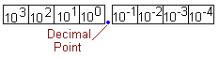
Decimal Numbers
The decimal number system has ten digits: 0, 1, 2, 3, 4, 5, 6, 7, 8, and 9
The decimal numbering system has a base of 10 with each position weighted by a factor of 10:
The value of a decimal number is the sum of the digits after each digit has been multiplied by its weight, as Examples 2–1 and 2–2 illustrate.
5
Notes:
5
5
5
0 through 9, represents a certain quantity.
if you wish to express a quantity greater than nine, you use two or more digits, and the position of each digit within the number tells you the magnitude it represents. If, for example, you wish to express the quantity twenty-three, you use
(by their respective positions in the number) the digit 2 to represent the quantity twenty and the digit 3 to represent the quantity three, as illustrated below.
The digit 2 has a weight of The digit 3 has a weight
10 in this position. of 1 in this position.
2 3
2 * 10 + 3 * 1
20 + 3
23
The position of each digit in a decimal number indicates the magnitude of the quantity represented and can be assigned a weight. The weights for whole numbers are positive powers of ten that increase from right to left, beginning with 100 = 1.
c105 104 103 102 101 100
For fractional numbers, the weights are negative powers of ten that decrease from left to right beginning with 10-1.
The value of a decimal number is the sum of the digits after each digit has been multiplied
by its weight, as Examples 2–1 and 2–2 illustrate.
5

Slide 6
Checkup
1. What weight does the digit 7 have in each of the following numbers?
(a) 1370 (b) 6725 (c) 7051 (d) 58.72
2. Express each of the following decimal numbers as a sum of the products obtained by multiplying each digit by its appropriate weight:
(a) 51 (b) 137 (c) 1492 (d) 106.58
(a) 1370: 10 (b) 6725: 100 (c) 7051: 1000 (d) 58.72: 0.1
(d) 106.58 = (1 * 100) + (0 * 10) + (6 * 1) + (5 * 0.1) + (8 * 0.01)
6
Notes:
6
6
6
(a) 51 = (5 * 10) + (1 * 1)
(b) 137 = (1 * 100) + (3 * 10) + (7 * 1)
(c) 1492 = (1 * 1000) + (4 * 100) + (9 * 10) + (2 * 1)
(d) 106.58 = (1 * 100) + (0 * 10) + (6 * 1) + (5 * 0.1) + (8 * 0.01)
6

Slide 7
Section 2–1 Decimal Numbers
1. What is the weight of 7 in each of the following decimal numbers?
(a) 1947 (b) 1799 (c) 1979
2. Express each of the following decimal numbers as a power of ten:
(a) 1000 (b) 10000000 (c) 1000000000
7
Notes:
7
7
7

Slide 8
Section 2–1 Decimal Numbers
1. What is the weight of 7 in each of the following decimal numbers?
(a) 1947 (b) 1799 (c) 1979
2. Express each of the following decimal numbers as a power of ten:
(a) 1000 (b) 10000000 (c) 1000000000
3. Give the value of each digit in the following decimal numbers:
(a) 263 (b) 5436 (c) 234543
4. How high can you count with six decimal digits?
8
Notes:
8
8
8

Slide 9
Binary Numbers
Two digits called bits: 0 or 1
Right most bit is least significant bit
Left most bit is most significant bit
Each position is weighted by a factor of 2.
2³ 2² 2¹ 2⁰ . 2⁻¹ 2⁻² 2⁻³ 2⁻⁴
Decimal point
9
Notes:
9
9
9

Slide 10
Counting in Binary
Decimal Number Binary Number
0 0 0 0 0 1 0 0 0 1 2 0 0 1 0 3 0 0 1 1 4 0 1 0 0 5 0 1 0 1 6 0 1 1 0 7 0 1 1 1 8 1 0 0 0 9 1 0 0 1 10 1 0 1 0 11 1 0 1 1 12 1 1 0 0 13 1 1 0 1 14 1 1 1 0 15 1 1 1 1
2³ 2² 2¹ 2⁰
Largest decimal number =
2^{n} - 1
10
Notes:
10
10
10

Slide 11
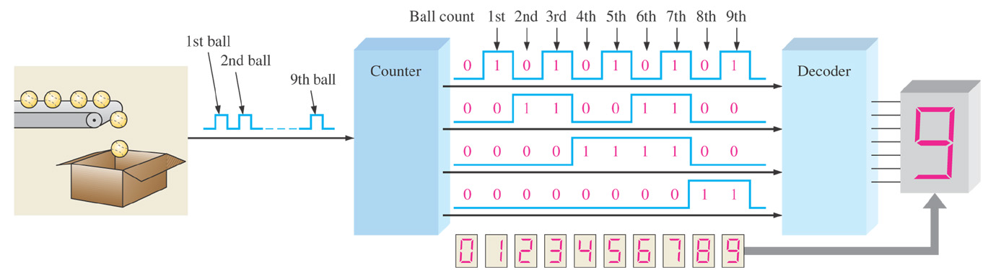
Figure 2–1 Illustration of a simple binary counting application.
InfoNote
Processors use binary numbers to select memory locations. Each location is assigned a unique number called an address. Some microprocessors, for example, have 32 address lines which can select 232 (4,294,967,296) unique
locations.
Thomas L. Floyd Digital Fundamentals, 9e
11
Copyright ©2006 by Pearson Education, Inc. Upper Saddle River, New Jersey 07458 All rights reserved.
Notes:
11
11
11
11

Slide 12
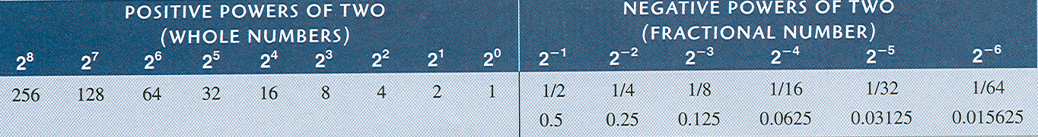
Binary Numbers
The binary number system has two digits: 0 and 1
The binary numbering system has a base of 2 with each position weighted by a factor of 2:
12
Notes:
12
12
12

Slide 13
Binary to Decimal
Add the weights of all the bits that are 1.
Ignore the bits that are 0.
Convert 1101101 to decimal.
1st determine the weights
2⁶ 2⁵ 2⁴ 2³ 2² 2¹ 2⁰ 1 1 0 1 1 0 1
1 1 0 1 1 0 1 = 2⁶ + 2⁵ + 2³ + 2² + 2⁰
= 64 + 32 + 8 + 4 + 1
= 109
13
Notes:
13
13
13
Practise: Convert the binary number 10.111 to decimal.
Section 2–2 Checkup
1. What is the largest decimal number that can be represented in binary with eight bits?
2. Determine the weight of the 1 in the binary number 10000.
3. Convert the binary number 10111101.011 to decimal.
13

Slide 14
Decimal-to-Binary Conversion
Sum-of-weights method
Repeated division-by-2 method
Conversion of decimal fractions to binary
14
Notes:
14
14
14

Slide 15
Decimal-to-Binary Conversion
Sum-of-weights method
Determine the set of binary weights whose sum is equal to the decimal number.
An easy way to remember binary weights is that the lowest is 1, which is 2⁰, and that by doubling any weight, you get the next higher weight; thus, a list of seven binary weights would be 64, 32, 16, 8, 4, 2, 1 as you learned in the last section.
9 = 8 + 1 or 9 = 2³ + 2⁰ = 2³ 2² 2¹ 2⁰=1 0 0 1
15
Notes:
15
15
15

Slide 16
Repeated Division by 2
Divide the number by 2 and write down the remainder.
Continue the process until the whole-number quotient is 0.
16
Notes:
16
16
16

Slide 17
Repeated Division by 2
17
Notes:
17
17
17

Slide 18
Repeated Division by 2
Convert decimal 19 to binary.
Convert decimal 45 to binary.
18
Notes:
18
18
18

Slide 19
Repeated Division by 2
Convert decimal 19 to binary.
Convert decimal 45 to binary.
19
Notes:
19
19
19

Slide 20
Decimal Fractions
Sum-of-Weights
The sum-of-weights method can be applied to fractional decimal numbers, as shown in the following example:
0.625 = 0.5 + 0.125 = 2⁻¹ + 2⁻³ = 0.101
There is a 1 in the 2⁻¹ position, a 0 in the 2⁻² position, and a 1 in the 2⁻³ position.
20
Notes:
20
20
20

Slide 21
Decimal Fractions
Repeated multiplication by 2
Multiply the decimal fraction by 2
Write down the carry bit if more than 1
Continue process until you have the desired number of bits or when the fractional part is all zeros.
21
Notes:
21
21
21

Slide 22
Convert 0.3125 to binary
Carry MSB LSB
0.0 1 0 1
0.3125 X 2 = 0.625 0
0.625 X 2 = 1.25 1
0.25 X 2 = 0.50 0
0.50 X 2 = 1.00 1
22
Notes:
22
22
22

Slide 23
Checkup
1. Convert each decimal number to binary by using the sum-of-weights method:
(a) 23 (b) 57 (c) 45.5
2. Convert each decimal number to binary by using the repeated division-by-2 method (repeated multiplication-by-2 for fractions):
(a) 14 (b) 21 (c) 0.375
(a) 23 = 10111 (b) 57 = 111001 (c) 45.5 = 101101.1
(a) 14 = 1110 (b) 21 = 10101 (c) 0.375 = 0.011
23
Notes:
23
23
23

Slide 24
Binary Arithmetic
Binary addition
Binary subtraction
Binary multiplication
Binary division
24
Notes:
24
24
24

Slide 25
Binary addition
The four basic rules for adding binary digits (bits) are as follows:
0 + 0 = 0 Sum of 0 with a carry of 0
0 + 1 = 1 Sum of 1 with a carry of 0
1 + 0 = 1 Sum of 1 with a carry of 0
1 + 1 = 10 Sum of 0 with a carry of 1
25
Notes:
25
25
25

Slide 26
Binary addition
Add the following binary numbers:
(a)11 + 11(b)100 + 10(c)111 + 11(d)110 + 100
26
Notes:
26
26
26
Section 2–4 Binary Arithmetic
1. (a) 1101 + 1010 = 10111 (b) 10111 + 01101 = 100100
2. (a) 1101 - 0100 = 1001 (b) 1001 - 0111 = 0010
3. (a) 110 * 111 = 101010 (b) 1100 , 011 = 100
Section 2–6 Signed Numbers
1. Sign-magnitude: +9 = 00001001
2. 1’s comp: -33 = 11011110
3. 2’s comp: -46 = 11010010
4. Sign bit, exponent, and mantissa
Section 2–7 Arithmetic Operations with Signed Numbers
1. Cases of addition: positive number is larger, negative number is larger, both are positive, both
are negative
2. 00100001 + 10111100 = 11011101
3. 01110111 - 00110010 = 01000101
4. Sign of product is positive.
5. 00000101 * 01111111 = 01001111011
6. Sign of quotient is negative.
7. 00110000 , 00001100 = 00000100
26

Slide 27
Binary Subtraction
The four basic rules for adding binary digits (bits) are as follows:
0 - 0 = 0
1 - 1 = 0
1 - 0 = 1
10 - 1 = 1 0 - 1 with a borrow of 1
11 3
-01 -1
10 2
11 3
-10 -2
1 1
101 5
-011 -3
10 2
27
Notes:
27
27
27

Slide 28
Binary Multiplication
The four basic rules for adding binary digits (bits) are as follows:
0 * 0 = 0
0 * 1 = 0
1 * 0 = 0
1 * 1 = 1
28
Notes:
28
28
28
It involves forming partial products, shifting each successive partial product left one
place, and then adding all the partial products.
28

Slide 29
Binary Division
Division in binary follows the same procedure as division in decimal
29
Notes:
29
29
29
29

Slide 30
Complements of Binary Numbers
1’s complements
2’s complements
30
Notes:
30
30
30

Slide 31
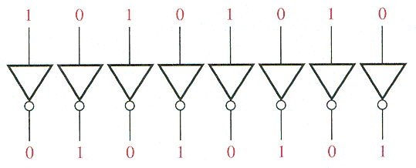
Complements of Binary Numbers
1’s complement
Change all 1s to 0s and all 0s to 1s
31
Notes:
31
31
31

Slide 32
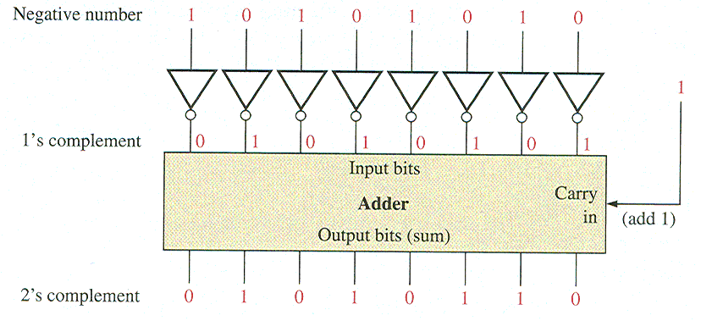
Complements of Binary Numbers
Find the 2’s complement
Solution
10110010
01001101 //1’s comp.
+ 1 //Add 1
01001110
2’s complement
Find 1’s complement and then add 1
32
Notes:
32
32
32
The 2’s complement of a negative binary number can be realized using inverters and an
adder, as indicated in Figure 2–3.
32

Slide 33
Complements of Binary Numbers
An alternative method of finding the 2’s complement of a binary number is as follows:
1. Start at the right with the LSB and write the bits as they are up to and including the first 1.
2. Take the 1’s complements of the remaining bits.
Find the 2’s complement of 10111000 using the alternative method.
Solution
33
Notes:
33
33
33

Slide 34
Checkup
1. Determine the 1’s complement of each binary number:
00011010 (b) 11110111 (c) 10001101
2. Determine the 2’s complement of each binary number:
(a) 00010110 (b) 11111100 (c) 10010001
(a)11100101 (b) 00001000 (c) 01110010
(a)11101010 (b) 00000100 (c) 01101111
34
Notes:
34
34
34

Slide 35
Signed Numbers
35
Notes:
35
35
35

Slide 36
Topics for Signed Numbers
Signed-magnitude form
1’s and 2’s complement form
Decimal value of signed numbers (How to convert)
Range of values (max and min)
Floating-point numbers
36
Notes:
36
36
36

Slide 37
Signed Numbers
Signed-magnitude form
The sign bit is the left-most bit in a signed binary number
A 0 sign bit indicates a positive magnitude
A 1 sign bit indicates a negative magnitude
37
Notes:
37
37
37

Slide 38
Signed Numbers
1’s complement form
Positive numbers in 1’s complement form are represented the same way as the positive sign-magnitude numbers.
A negative value is the 1’s complement of the corresponding positive value
+25 (00011001) as 11100110
2’s complement form
A negative value is the 2’s complement of the corresponding positive value
+25 =00011001 and -25 = 11100111
38
Notes:
38
38
38

Slide 39
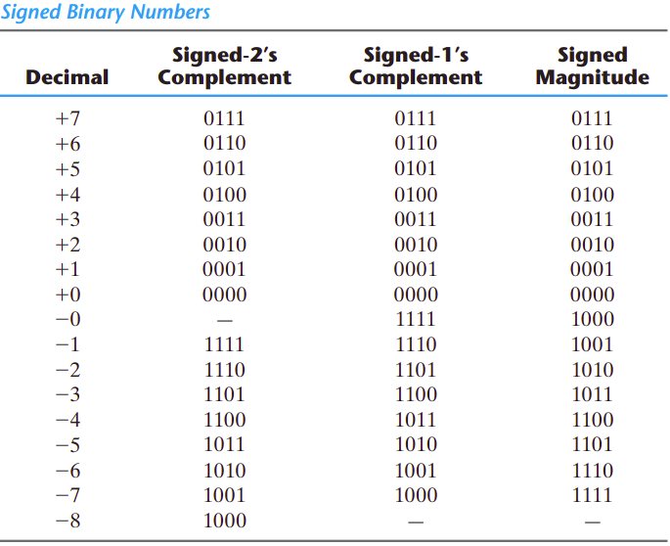
Signed Numbers
39
Notes:
39
39
39

Slide 40
Signed Numbers
Express the decimal number 39 as an 8-bit number in the sign-magnitude, 1’s complement, and 2’s complement forms.
Solution
First, write the 8-bit number for +39= 00100111
In the sign-magnitude form, -39 is produced by changing the sign bit to a 1 and leaving the magnitude bits as they are. The number is 10100111
In the 1’s complement form, -39 is produced by taking the 1’s complement of +39
(00100111) 11011000
In the 2’s complement form, taking the 2’s complement of +39
(00100111) as follows:
11011000 1’s complement
+ 1
11011001 2’s complement
40
Notes:
40
40
40

Slide 41
Signed Numbers
Decimal value of signed numbers
Sign-magnitude
1’s complement
2’s complement
41
Notes:
41
41
41

Slide 42
Decimal value of signed numbers Sign-magnitude
Summing the weights in all the magnitude bit positions where there are 1s and ignoring those positions where there are zeros.
The sign is determined by examination of the sign bit.
42
Notes:
42
42
42

Slide 43
Decimal value of signed numbers Sign-magnitude
Determine the decimal value of this signed binary number expressed in sign-magnitude:
10010101. Solution
The seven magnitude bits and their powers-of-two weights are as follows:
2⁶ 2⁵ 2⁴ 2³ 2² 2¹ 2⁰
0 0 1 0 1 0 1
Summing the weights where there are 1s=16+4+1=21
The sign bit is 1; therefore, the decimal number is -21
43
Notes:
43
43
43
43

Slide 44
Decimal value of signed numbers 1’s Complement
Decimal values of positive numbers in the 1’s complement form are determined by summing the weights in all bit positions where there are 1s and ignoring those positions where there are zeros.
Decimal values of negative numbers are determined by assigning a negative value to the weight of the sign bit, summing all the weights where there are 1s, and adding 1 to the result.
44
Notes:
44
44
44

Slide 45
Decimal value of signed numbers 1’s Complement
Determine the decimal values of the signed binary numbers expressed in 1’s complement: (a) 00010111 (b) 11101000 Solution
(a) The bits and their powers-of-two weights for the positive number are as
-2⁷ 2⁶ 2⁵ 2⁴ 2³ 2² 2¹ 2⁰
0 0 0 1 0 1 1 1
Summing the weights where there are 1s=16 + 4 + 2 + 1 = 23
(b) The bits and their powers-of-two weights for the negative number are as follows.
Notice that the negative sign bit has a weight of -2⁷ or -128.
-2⁷ 2⁶ 2⁵ 2⁴ 2³ 2² 2¹ 2⁰
1 1 1 0 1 0 0 0
Summing the weights where there are 1s=-128 + 64 + 32 + 8 = -24
Adding 1 to the result, the final decimal number is -24 + 1 = -23
45
Notes:
45
45
45

Slide 46
Decimal value of signed numbers 2’s Complement
Decimal values of positive and negative numbers in the 2’s complement form are determined by summing the weights in all bit positions where there are 1s and ignoring those positions where there are zeros.
The weight of the sign bit in a negative number is given a negative value.
46
Notes:
46
46
46

Slide 47
Decimal value of signed numbers 2’s Complement
Determine the decimal values of the signed binary numbers expressed in 2’s complement: (a) 01010110 (b) 1010101 Solution
(a) The bits and their powers-of-two weights for the positive number are as follows:
-2⁷ 2⁶ 2⁵ 2⁴ 2³ 2² 2¹ 2⁰
0 1 0 1 0 1 1 0
Summing the weights where there are 1s= 64 + 16 + 4 + 2 = 86
(b) The bits and their powers-of-two weights for the negative number are as follows. Notice that the negative sign bit has a weight of 2⁷ =-128.
-2⁷ 2⁶ 2⁵ 2⁴ 2³ 2² 2¹ 2⁰
1 0 1 0 1 0 1 0
Summing the weights where there are 1s= -128 + 32 + 8 + 2 = -86
47
Notes:
47
47
47
From these examples, you can see why the 2’s complement form is preferred for representing signed integer numbers: To convert to decimal, it simply requires a summation of weights regardless of whether the number is positive or negative. The 1’s complement system requires adding 1 to the summation of weights for negative numbers but not for positive numbers. Also, the 1’s complement form is generally not used because two representations of zero (00000000 or 11111111) are possible.
47

Slide 48
Signed Numbers
Range of Values
Total combinations = 2^{n}
2’s complement form:
– (2^{n – 1}) to + (2^{n – 1} – 1)
Range for 8 bit number: n = 8 -(2⁸⁻¹) = -2⁷ = -128 minimum +(2⁸⁻¹) – 1 = +2⁷ - 1 = +127 maximum
Total combination of numbers is 2⁸ = 256.
48
Notes:
48
48
48
There is one less positive number than there are negative
numbers because zero is represented as a positive number (all zeros).
48

Slide 49
Signed Numbers
Range for 16 bit number: n = 16 -(2¹⁶⁻¹) = -2¹⁵ = -32768 minimum +(2¹⁶⁻¹) - 1 = +2¹⁵ = +32767 maximum Total combinations is 2¹⁶ = 65536 (64K)
8 bit examples:
10000000 =
-128
11111111 =
-1
10000001 =
-127
01111111 =
+127
49
Notes:
49
49
49

Slide 50
Signed Numbers
Floating-point numbers
Can represent very large or very small numbers based on scientific notation. Binary point “floats”.
Two Parts
Mantissa represents magnitude of number
Exponent represents number of places that binary point is to be moved
Three forms
Single-precision (32 bits) float
Double-precision (64 bits) double
Extended-precision (80 bits) long double
Also have Quadruple and Quadruple extended!
50
Notes:
50
50
50
The floating-point number system, based on scientific notation, is capable of
representing very large and very small numbers without an increase in the number of bits
and also for representing numbers that have both integer and fractional components.
A floating-point number (also known as a real number) consists of two parts plus a
sign. The mantissa is the part of a floating-point number that represents the magnitude of
the number and is between 0 and 1. The exponent is the part of a floating-point number
that represents the number of places that the decimal point (or binary point) is to be moved.
50

Slide 51
Single Precision
32 bits
S Exponent (E) Mantissa (fraction, F)
1 bit 8 bits 23 bits
ANSI/IEEE 754 standard
Mantissa (F) has hidden bit so actually has 24 bits. Gives 7 significant figures.
1st bit in mantissa is always a one
Exponent (E) is biased by 127 called Excess-127 Notation
Add 127 to exponent so easier to compare
Range of exponents is -126 to +128
Sign (S) bit tells whether number is negative or positive
51
Notes:
51
51
51
51
https://www.ias.ac.in/public/Volumes/reso/021/01/0011-0030.pdf
https://courses.lumenlearning.com/physics/chapter/1-3-accuracy-precision-and-significant-figures/
The precision of a measurement system is refers to how close the agreement is between repeated measurements
In the mantissa or fractional part, the binary point is understood to be to the left of
the 23 bits. Effectively, there are 24 bits in the mantissa because in any binary number the
left-most (most significant) bit is always a 1. Therefore, this 1 is understood to be there
although it does not occupy an actual bit position.
The eight bits in the exponent represent a biased exponent, which is obtained by adding
127 to the actual exponent. The purpose of the bias is to allow very large or very
small numbers without requiring a separate sign bit for the exponents. The biased exponent
allows a range of actual exponent values from -126 to +128.

Slide 52
Single Precision
Example: Convert 5777₁₀ to Floating Point
1st, convert to binary using divide by 2 method
5777₁₀ = 1011010010001₂
Positive number, so sign bit (S) equals 0.
2nd, count number of places to move binary point
1011010010001₂ = 1.011010010001 x 2¹²
Add 127 to 12 = 139₁₀ = 10001011₂
Mantissa is fractional part, 011010010001
Finally, put everything together
S E F
Fill in with trailing zeroes
0 10001011 01101001000100000000000
52
Notes:
52
52
52

Slide 53
Single Precision
32 bits
S Exponent (E) Mantissa (fraction, F)
1 bit 8 bits 23 bits
The general approach to determining the value of a floating-point number is expressed by the following formula:
Number =
Number = (-1)¹(1.10001110001)(2¹⁴⁵⁻¹²⁷)
= (-1)(1.10001110001)(2¹⁸) =
-1100011100010000000=-407,688
10001110001
0.5
0.03125
0.015625
0.0078125
0.0004882813
0.5551757813
1.5551757813
1 | 10010001 | 10001110001000000000000
53
Notes:
53
53
53
53

Slide 54
Checkup
1. Express the decimal number +9 as an 8-bit binary number in the sign-magnitude system.
2. Express the decimal number 233 as an 8-bit binary number in the 1’s complement system.
3. Express the decimal number 246 as an 8-bit binary number in the 2’s complement system.
4. List the three parts of a signed, floating-point number
54
Notes:
54
54
54

Slide 55
Special Cases
Zero and infinity are special cases
Can have +0 or -0 depending on sign bit
Can also have +∞ or ⁻∞
Not a Number (NaN)
if underflow or overflow
Type | Exponent | Mantissa
Zeroes | 0 | 0
Denormalized numbers | 0 | non zero
Normalized numbers | 1 to 2e − 2 | any
Infinities | 2e − 1 | 0
NaNs | 2e − 1 | non zero
55
Notes:
55
55
55

Slide 56
Examples
Type | Exponent | Mantissa | Value
Zero | 0000 0000 | 000 0000 0000 0000 0000 0000 | 0.0
One | 0111 1111 | 000 0000 0000 0000 0000 0000 | 1.0
Denormalized number | 0000 0000 | 100 0000 0000 0000 0000 0000 | 5.9×10⁻³⁹
Large normalized number | 1111 1110 | 111 1111 1111 1111 1111 1111 | 3.4×10³⁸
Small normalized number | 0000 0001 | 000 0000 0000 0000 0000 0000 | 1.18×10⁻³⁸
Infinity | 1111 1111 | 000 0000 0000 0000 0000 0000 | Infinity
NaN | 1111 1111 | 010 0000 0000 0000 0000 0000 | NaN
56
Notes:
56
56
56

Slide 57
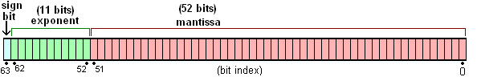
Double Precision
Exponent has 11 bits so uses Excess-1023 Notation
Mantissa has 53 bits (one hidden)
53 bits gives 16 significant figures
57
Notes:
57
57
57

Slide 58
Arithmetic Operations with Signed Numbers
Addition
Subtraction
Multiplication
Division
58
Notes:
58
58
58

Slide 59
Arithmetic Operations with Signed Numbers
Addition of Signed Numbers
The parts of an addition function are:
Augend - The first number
Addend - The second number
Sum - The result
Numbers are always added two at a time.
59
Notes:
59
59
59

Slide 60
Arithmetic Operations with Signed Numbers
Four conditions for adding numbers:
1. Both numbers are positive.
2. A positive number that is larger than a negative number.
3. A negative number that is larger than a positive number.
4. Both numbers are negative.
60
Notes:
60
60
60

Slide 61
Arithmetic Operations with Signed Numbers
Signs for Addition
When both numbers are positive, the sum is positive.
When the larger number is positive and the smaller is negative, the sum is positive. The carry is discarded.
61
Notes:
61
61
61

Slide 62
Arithmetic Operations with Signed Numbers
Signs for Addition
When the larger number is negative and the smaller is positive, the sum is negative (2’s complement form).
When both numbers are negative, the sum is negative (2’s complement form). The carry bit is discarded.
62
Notes:
62
62
62

Slide 63
Examples (8 bit numbers)
Add 7 and 4 (both positive)
Add 15 and -6 (positive > negative)
Add 16 and -24 (negative > positive)
Add -5 and -9 (both negative)
00000111 7 +00000100 + 4 00001011 11
00001111 15 +11111010 + -6 1 00001001 9
Discard carry
00010000 16 +11101000 + -24 11111000 -8
Sign bit is negative so negative number in 2’s complement form
11111011 -5 +11110111 + -9 1 11110010 -14
Discard carry
63
Notes:
63
63
63

Slide 64
Overflow
Overflow occurs when number of bits in sum exceeds number of bits in addend or augend.
Overflow is indicated by the wrong sign.
Occurs only when both numbers are positive or both numbers are negative
01111101 126
+ 00111010 + 58 _________ ____
10110111 183
Sign Incorrect Magnitude Incorrect
64
Notes:
64
64
64

Slide 65
Add the signed numbers: 01000100, 00011011, 00001110, and 00010010.
Solution: The equivalent decimal additions are given for reference.
68 01000100
+ 27 + 00011011 Add 1st two numbers
95 01011111 1st sum
+ 14 + 00001110 Add 3rd number
109 01101101 2nd sum
+ 18 + 00010010 Add 4th number
127 01111111 Final sum
65
Notes:
65
65
65

Slide 66
Arithmetic Operations with Signed Numbers
Subtraction of Signed Numbers
The parts of a subtraction function are:
Minuend - The first number
Subtrahend - The second number
Difference - The result
Subtraction is addition with the sign of the subtrahend changed.
66
Notes:
66
66
66

Slide 67
Arithmetic Operations with Signed Numbers
Subtraction
The sign of a positive or negative binary number is changed by taking its 2’s complement
To subtract two signed numbers, take the 2’s complement of the subtrahend and add. Discard any final carry bit.
67
Notes:
67
67
67

Slide 68
Subtraction Examples
Find 8 minus 3.
Find 12 minus -9.
Find -25 minus 19.
Find -120 minus -30.
00001000 8 +11111101 - 3 1 00000101 5
Minuend Subtrahend Difference
Discard carry
00001100 12 +00001001 - -9 00010101 21
11100111 -25 +11101101 - 19 1 11010100 -44
Discard carry
10001000 -120 +00011110 - -30 10100110 -90
68
Notes:
68
68
68

Slide 69
Arithmetic Operations with Signed Numbers
Multiplication of Signed Numbers
The parts of a multiplication function are:
Multiplicand - First number
Multiplier - Second number
Product - Result
Multiplication is equivalent to adding a number to itself a number of times equal to the multiplier.
69
Notes:
69
69
69

Slide 70
Arithmetic Operations with Signed Numbers
There are two methods for multiplication:
Direct addition
add multiplicand multiple times equal to the multiplier
Can take a long time if multiplier is large
Partial products
Similar to long hand multiplication
The method of partial products is the most commonly used.
70
Notes:
70
70
70

Slide 71
Arithmetic Operations with Signed Numbers
Multiplication of Signed Numbers
If the signs are the same, the product is positive. (+ X + = + or - X - = +)
If the signs are different, the product is negative. (+ X - = - or - X + = -)
71
Notes:
71
71
71

Slide 72
Multiplication Example
Both numbers must be in uncomplemented form
Multiply 3 by -5.
Opposite signs, so product will be negative.
3₁₀ = 00000011₂ -5₁₀ = 11111011₂ 2’s complement of -5 00000101
00000011 Multiplicand X 00000101 Multiplier 00000011 First partial product + 0000000 Second partial product 00000011 Sum of 1st and 2nd
+ 000011 Third partial product 00001111 Sum and Final Product
Final result is negative, so take 2’s complement. 11110001 is the result which in decimal is -15.
72
Notes:
72
72
72

Slide 73
Arithmetic Operations with Signed Numbers
Division of Signed Numbers
The parts of a division operation are:
Dividend
Divisor
Quotient
Division is equivalent to subtracting the divisor from the dividend a number of times equal to the quotient.
73
Notes:
73
73
73

Slide 74
Arithmetic Operations with Signed Numbers
Division of Signed Numbers
If the signs are the same, the quotient is positive. (+ ÷ + = + or - ÷ - = +)
If the signs are different, the quotient is negative. (+ ÷ - = - or - ÷ + = -)
74
Notes:
74
74
74

Slide 75
Division Example
Both numbers must be in uncomplemented form
Divide 01100100 by 00110010.
Both numbers are positive so quotient will be positive. Set the quotient to zero initially.
Subtract the divisor from the dividend by using 2’s complement addition. (11001110) Ignore the carry bit.
Subtract the divisor from the 1st partial remainder using 2’s complement addition.
75
Notes:
75
75
75

Slide 76
Division Example
Both numbers must be in uncomplemented form
Divide 01100100 by 00110010.
01100100 Dividend + 11001110 2’s complement of Divisor 1 00110010 First partial remainder
Add 1 to quotient: 00000000 + 1 = 00000001
quotient: 00000000
00110010 First partial remainder + 11001110 2’s complement of Divisor 1 00000000 zero remainder
Add 1 to quotient: 00000001 + 1 = 00000010
So final quotient is 00000010 and final remainder is 00000000
76
Notes:
76
76
76

Slide 77
Checkup
Checkup
List the four cases when numbers are added.
Answer: : positive number is larger, negative number is larger, both are positive, both
are negative
2. Add the signed numbers 00100001 and 10111100.
Answer: 11011101
3. Subtract the signed numbers 00110010 from 01110111.
Answer: 01000101
4. What is the sign of the product when two negative numbers are multiplied?
Sign of product is positive.
5. Multiply 01111111 by 00000101.
01001111011
6. What is the sign of the quotient when a positive number is divided by a negative number?
Sign of quotient is negative.
7. Divide 00110000 by 00001100.
00000100
Notes:
77
77

Slide 78
Hexadecimal Numbers
78
Notes:
78
78
78

Slide 79
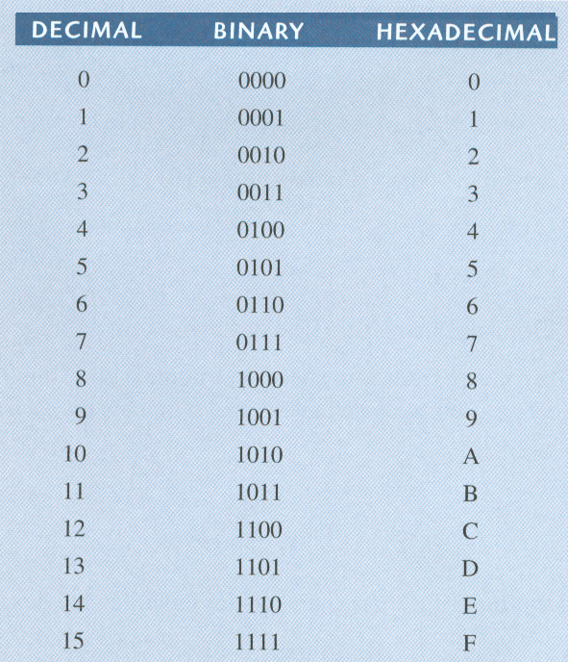
Hexadecimal Numbers
Decimal, binary, and hexadecimal numbers
4 bits is a nibble
FF₁₆ = 255₁₀
79
Notes:
79
79
79

Slide 80
Hexadecimal Numbers
Binary-to-hexadecimal conversion
Hexadecimal-to-decimal conversion
Decimal-to-hexadecimal conversion
80
Notes:
80
80
80

Slide 81
Hexadecimal Numbers
Binary-to-hexadecimal conversion
Break the binary number into 4-bit groups
Replace each group with the hexadecimal equivalent
111111000101101001
3F16916
Convert 1100101001010111 to Hex
C A 5 7 = CA57₁₆
Convert 10A4₁₆ to binary
CF8E16
1100111110001110
0001 0000 1010 0100 = 0001000010100100
81
Notes:
81
81
81

Slide 82
Hexadecimal Numbers
Hexadecimal-to-decimal conversion
Convert the hexadecimal to groups of 4-bit binary
Convert the binary to decimal
16³ 16² 16¹ 16⁰
4096 256 16 1
1 C
00011100
= 2⁴ + 2³ + 2² = 16 + 8 + 4 = 2810
E516==22910
B2F816= 45,81610
A 8 5
101010000101= 2¹¹ + 2⁹ + 2⁷ + 2² + 2⁰
= 2048 + 512 + 128 + 4 + 1
= 269310
82
Notes:
82
82
82

Slide 83
Hexadecimal Numbers
Decimal-to-hexadecimal conversion
Convert to binary by repeated division by 2 and then convert binary to hex
Repeated division by 16
83
Notes:
83
83
83

Slide 84
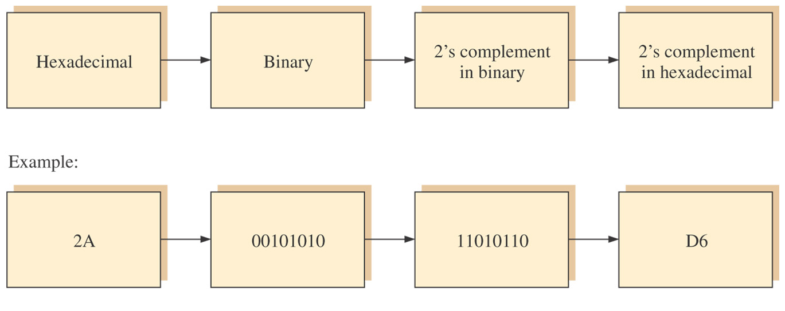
Figure 2–4 Getting the 2’s complement of a hexadecimal number, Method 1.
84
Notes:
84
84
84
84

Slide 85
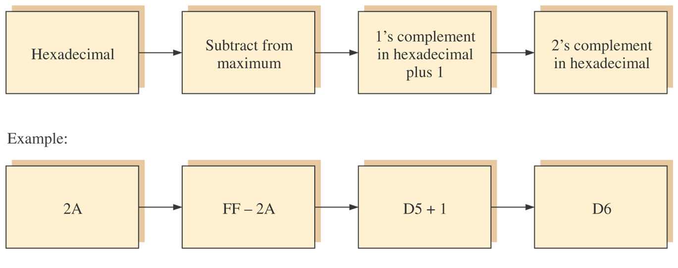
Figure 2–5 Getting the 2’s complement of a hexadecimal number, Method 2.
85
Notes:
85
85
85
85

Slide 86
Octal
Not used as frequently
Convert binary to octal
Can group in 3 bits instead of 4 bits like Hex.
Symbols range from 0 to 7
Example. Convert 01011010 to octal.
1 3 2 = 132₈
Example. Convert 105₈ to binary.
01 000 101 = 01000101
86
Notes:
86
86
86

Slide 87
Binary Coded Decimal (BCD)
87
Notes:
87
87
87

Slide 88
Binary Coded Decimal (BCD)
Decimal and BCD digits
88
Notes:
88
88
88

Slide 89
Digital Codes
89
Notes:
89
89
89

Slide 90
Digital Codes
Gray code
ASCII code
90
Notes:
90
90
90

Slide 91
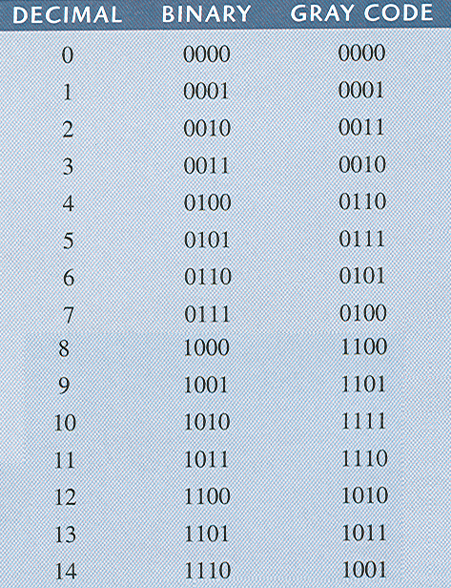
Gray Code
Unweighted - no weights associated to the bit positions
Only one bit change from one code word to the other.
Minimizes chance of error
91
Notes:
91
91
91

Slide 92
Conversion
Binary to Gray code
MSB of Gray is set to the MSB of binary
Going from left to right, add each adjacent pair of binary code bits. Discard carries.
Example. Convert 10110 to Gray Code
MSB of binary number is 1, so set the MSB of the Gray Code to 1.
1 0 1 1 0 Binary
1+0
1+1
Add adjacent pairs of binary numbers
0+1
1+0
1
1 Gray code
1
0
1
92
Notes:
92
92
92

Slide 93
Conversion
Gray code to Binary
MSB of binary is set to the MSB of Gray code
Going from left to right, add the binary bit to the next Gray code bit. Discard carries.
Example. Convert 11011 to binary
MSB of Gray Code is 1, so set the MSB of the binary number to 1.
1 1 0 1 1 Gray Code
+
+
+
+
1 Binary
0
0
1
0
93
Notes:
93
93
93

Slide 94
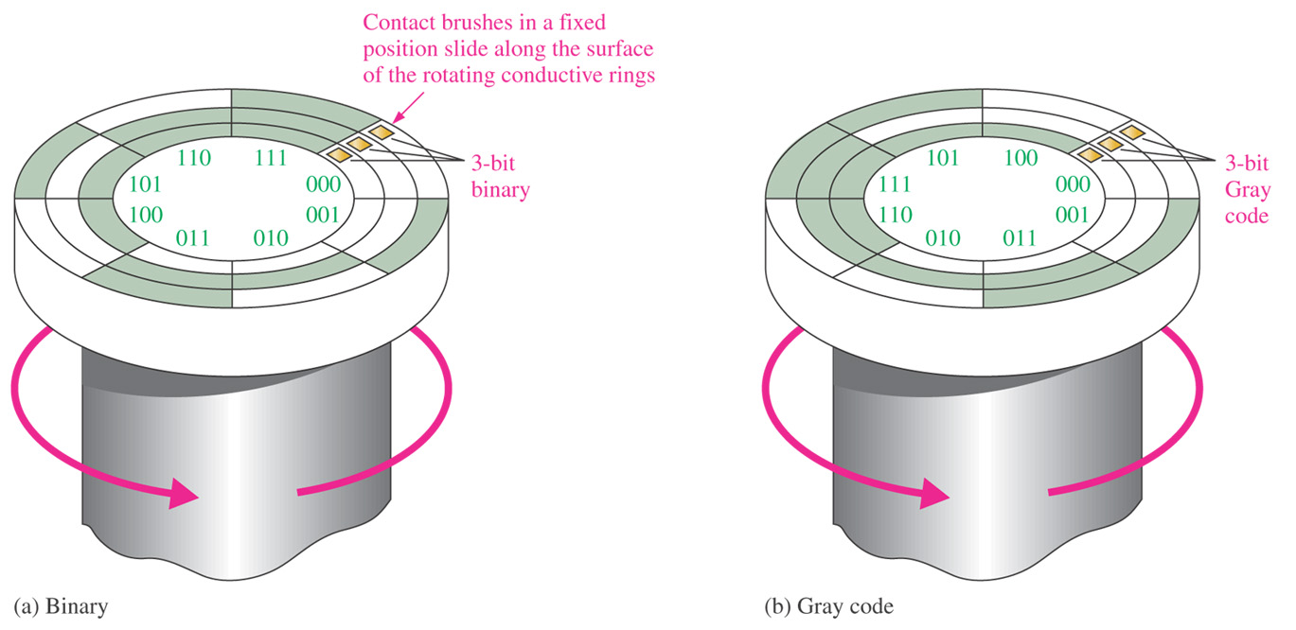
Figure 2–7 A simplified illustration of how the Gray code solves the error problem in shaft position encoders.
94
Notes:
94
94
94
94

Slide 95
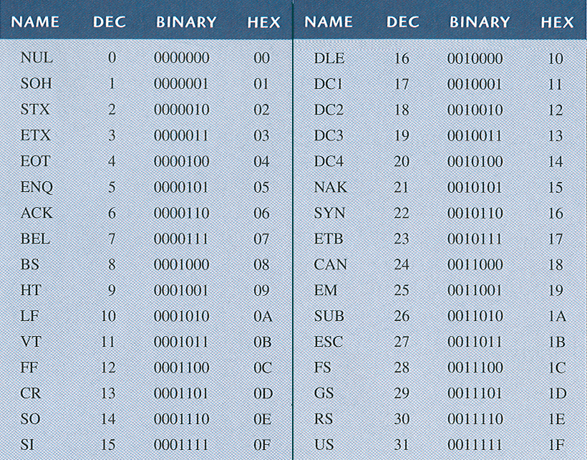
American Standard Code for Information Interchange (ASCII)
ASCII code (1st 32 are control characters)
128 characters
Uses 7 bits
95
Notes:
95
95
95

Slide 96
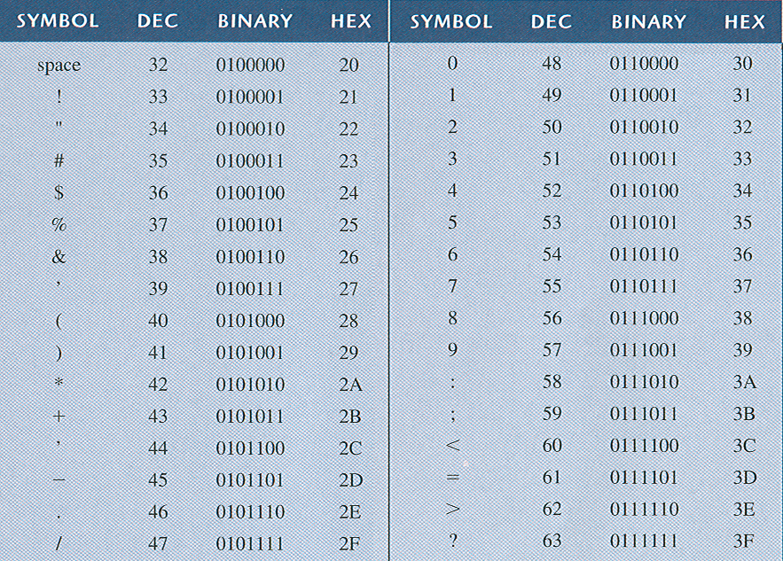
ASCII code (graphic symbols 20h – 3Fh)
96
Notes:
96
96
96

Slide 97
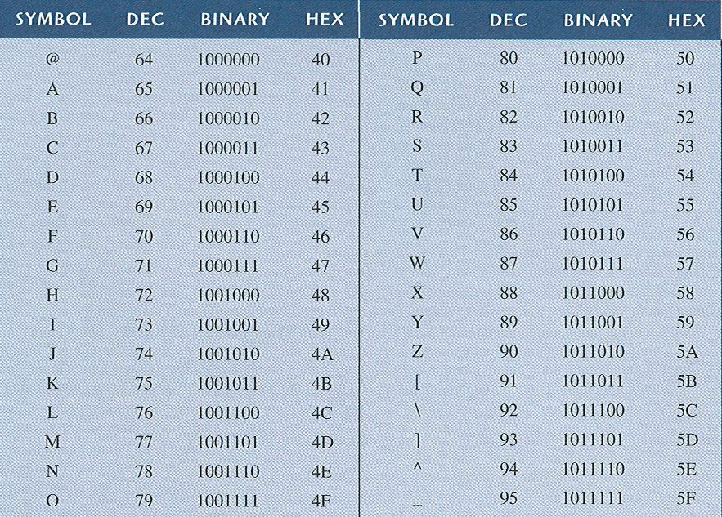
Digital Codes
ASCII code (graphic symbols 40h – 5Fh)
97
Notes:
97
97
97

Slide 98
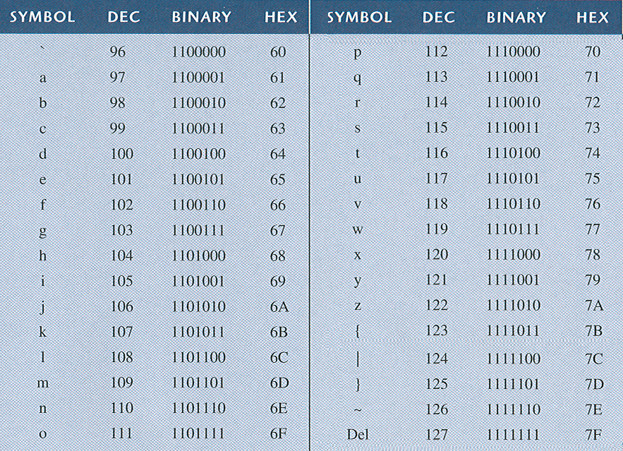
Digital Codes
ASCII code (graphic symbols 60h – 7Fh)
98
Notes:
98
98
98

Slide 99
Digital Codes
Extended ASCII code (80h – FFh)
Non-English alphabetic characters
Currency symbols
Greek letters
Math symbols
Drawing characters
Bar graphing characters
Shading characters
99
Notes:
99
99
99

Slide 100
Error Detection and Correction Codes
100
Notes:
100
100
100

Slide 101
Error Detection and Correction Codes
Parity error codes
Odd parity – odd sum of 1’s
Even parity – even sum of 1’s
The sum includes the parity bit
Parity bit can be at beginning or end of the code.
Can detect single bit errors, but not 2 or more errors.
Hamming error codes
101
Notes:
101
101
101

Slide 102
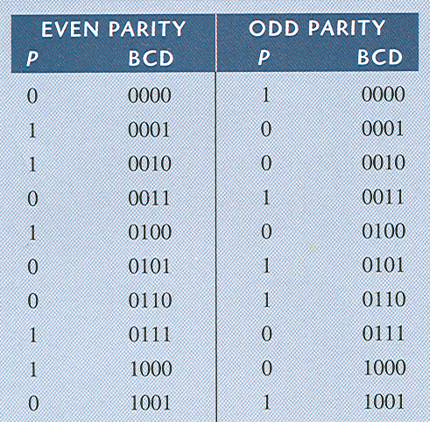
Error Detection and Correction Codes
Parity error codes
even parity set a parity bit to 1 if the total number of ones in the positions it checks is odd.
102
Notes:
102
102
102

Slide 103
Error Detection and Correction
Codes
Assign the proper even parity bit to the following code groups:
(a) 1010 (b) 111000 (c) 101101
(d) 1000111001001 (e) 101101011111
Solution
Make the parity bit either 1 or 0 as necessary to make the total number of 1s even. The
parity bit will be the left-most bit (color).
(a) 01010 (b) 1111000 (c) 0101101
(d) 0100011100101 (e) 0101101011111
103
Notes:
103
103
103

Slide 104
Error Detection and Correction Codes
Hamming error codes
Redundant bits –
Redundant bits are extra binary bits that are generated and added to the information-carrying bits of data transfer to ensure that no bits were lost during the data transfer.
The number of redundant bits can be calculated using the following formula: 2^r ≥ m + r + 1
where, r = redundant bit, m = data bit
Suppose the number of data bits is 7, then the number of redundant bits can be calculated using:
= 2^4 ≥ 7 + 4 + 1
Thus, the number of redundant bits= 4
104
Notes:
104
104
104

Slide 105
Error Detection and Correction Codes
Hamming error codes
Parity bits –
A parity bit is a bit appended to a data of binary bits to ensure that the total number of 1’s in the data is even or odd. Parity bits are used for error detection.
105
Notes:
105
105
105

Slide 106
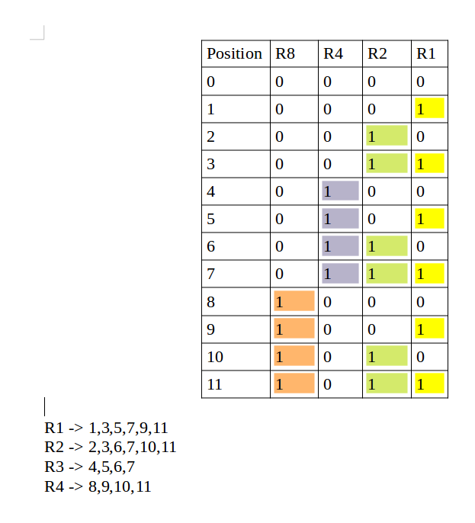
Error Detection and Correction Codes
0000000 0000111 0011011 0011110 0101010 0101101 0110011 0110100 1001011 1001100 1010010 1010101 1100001 1100110 1111000 1111111 | 0 1 2 3 4 5 6 7 8 9 A B C D E F
Hamming error codes
Hamming code words
Hex equivalent of the data bits
106
Notes:
106
106
106
https://www.geeksforgeeks.org/hamming-code-in-computer-network/

Slide 107
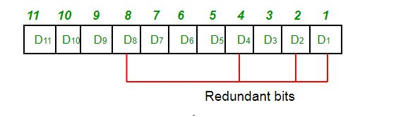
Error Detection and Correction Codes
Determining the position of redundant bits –
As in the above example:
The number of data bits = 7
The number of redundant bits = 4
The total number of bits = 11
The redundant bits are placed at positions corresponding to power of 2- 1, 2, 4, and 8
107
Notes:
107
107
107
https://www.geeksforgeeks.org/hamming-code-in-computer-network/

Slide 108
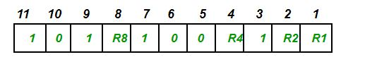
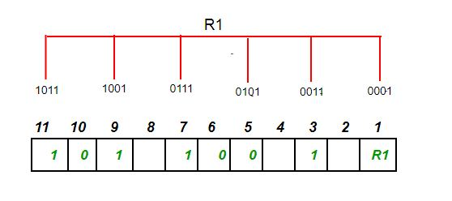
Error Detection and Correction Codes
Suppose the data to be transmitted is 1011001, the bits will be placed as follows:
R1 bit is calculated using parity check at all the bits positions whose binary representation includes a 1 in the least significant position. R1: bits 1, 3, 5, 7, 9, 11
108
Notes:
108
108
108
https://www.geeksforgeeks.org/hamming-code-in-computer-network/

Slide 109
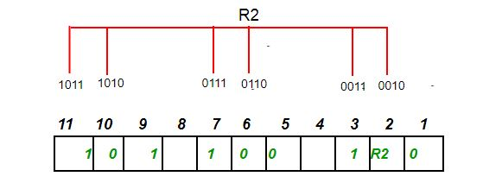
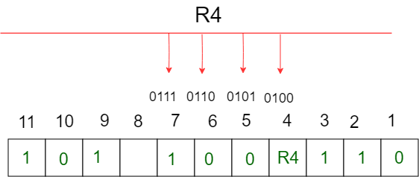
Error Detection and Correction Codes
R2 bit is calculated using parity check at all the bits positions whose binary representation includes a 1 in the second position from the least significant bit. R2: bits 2,3,6,7,10,11
109
Notes:
109
109
109
https://www.geeksforgeeks.org/hamming-code-in-computer-network/

Slide 110
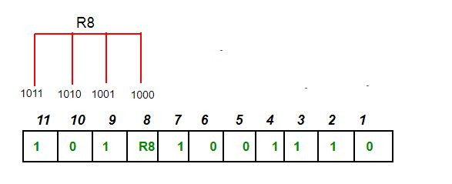
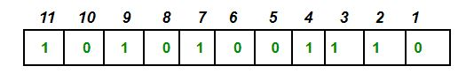
Error Detection and Correction Codes
110
Notes:
110
110
110
https://www.geeksforgeeks.org/hamming-code-in-computer-network/

Slide 111
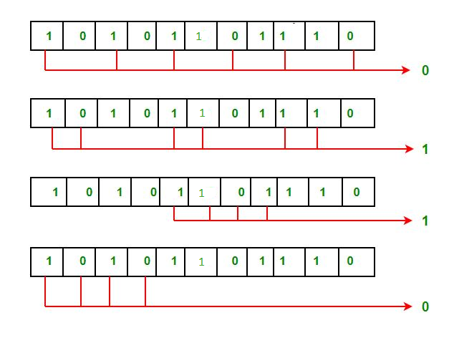
Error Detection and Correction Codes
Error detection and correction –Suppose in the above example the 6th bit is changed from 0 to 1 during data transmission, then it gives new parity values in the binary number:
The bits give the binary number as 0110 whose decimal representation is 6. Thus, the bit 6 contains an error. To correct the error the 6th bit is changed from 1 to 0.
111
Notes:
111
111
111
https://www.geeksforgeeks.org/hamming-code-in-computer-network/

